Slide 1


DOCKER PROJECT
“Thought Flow”
UPES
A PRESENTATION BY:
Aditya Sharma R2142210053 B1-(H) CCVT(III)
Lakshit Joshi R2142210450 B1-(H) CCVT(III)
Vibhor Minocha R2142210852 B1-(H) CCVT(III)
Divyanshu Saini R2142210289 B1-(H) CCVT(III)
Divyam Goyal R2142210283 B1-(H) CCVT(III)

Slide 2







Content

Slide 3

INTRODUCTION
International banking involves the exchange of funds and financial services between different countries. It provides companies with greater access to a global network of customers, suppliers and partners, allowing for an efficient transfer of funds over borders and through foreign currency conversions. International banking gives firms the ability to trade in foreign markets with confidence, although they must be aware of the associated risks.

Slide 4
INTRODUCTION
In the digital age, where the exchange of ideas and experiences has never been more vibrant, the creation of a Blogging Website has evolved from a simple online diary into a powerful platform for individuals and organizations to connect, share, and inspire.
Welcome to our exciting project, the “Thought Flow”, where we aim to craft a dynamic online space where words come to life and ideas find their voice.
Our main focus will be implementation of Docker, a revolutionary technology that has transformed the way we package, distribute, and deploy applications. Our project serves as a prime example of Docker's capabilities.
We have leveraged Docker to create a robust and adaptable web application, designed for bloggers, content creators, and developers alike. By containerizing various components of the website, we have simplified the development process and made it easier to collaborate and scale.

Slide 5

OBJECTIVES

Slide 6
OBJECTIVES
Mastering Technologies – Gaining experience in microservices, docker, and integration with 3rd party services.
Seamless Blogging Experience – Implement a blogging web application that ensures low response time and all-time availability of the application with a flawless blogging experience.
Implementing Microservices - Microservices allow us to break down the monolithic structure of a traditional blogging platform into smaller, more manageable services. Each microservice will handle a specific aspect of the platform, such as content service, blog interaction, authentication, notification and more. This approach provides several benefits, including improved scalability, easier maintenance, and the ability to develop and deploy each service independently.

Slide 7
OBJECTIVES
Integration of K8s – To manage and orchestrate our microservices efficiently, we aim to integrate Kubernetes (K8s) into our architecture. Kubernetes is a powerful container orchestration platform that will help us automate deployment, scaling, and management of our dockerized microservices. With Kubernetes, we can ensure high availability, fault tolerance, and seamless scaling to meet the demands of our growing user base.
Implementation of REST API – The implementation of a REST (Representational State Transfer) API is another crucial objective. Our microservices will communicate with each other and with the frontend through RESTful APIs. This approach ensures that our services remain loosely coupled and can be developed independently. It also allows us to offer an API to external developers, enabling them to build applications or integrations on top of our blogging platform.

Slide 8
OBJECTIVES
Cloud Integration - Cloud integration is a key aspect of our dockerized Blogging Website. We plan to leverage cloud services, such as AWS to host and manage our containerized microservices. Cloud integration offers advantages like scalability, reliability, and cost optimization. Additionally, it allows us to take advantage of cloud-based databases, storage, and networking services to enhance the performance and resilience of our platform.
Integration of Jira - Another significant objective for our dockerized Blogging Website project is the integration of Jira, a popular issue and project tracking tool by Atlassian. Integrating Jira into our development workflow and project management processes will play a crucial role in streamlining our development lifecycle.

Slide 9

TECHNOLOGY STACK
It is essential that you make sure to understand the legal and regulatory requirements associated with international banking. Being aware of things such as where the money is kept and how transfer costs are established is important. Additionally, you should ensure you choose a financial institution that is reliable and trustworthy. Finally, make sure the international banking institution you choose offers the services to meet your financial and investment needs.

Slide 10




TECHNOLOGY STACK
Version Control
Database
Backend
Frontend

Slide 11



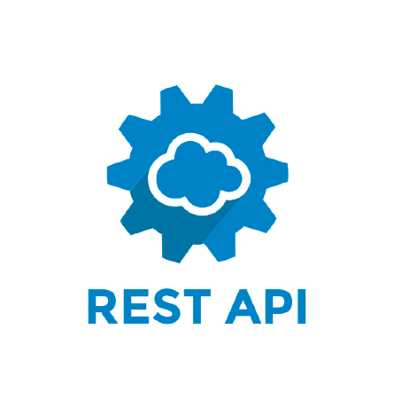

TECHNOLOGY STACK
Project Manager
Orchestration
Containerization
Communication
Of Microservices
Cloud

Slide 12
MICROSERVICES

Slide 13
MICROSERVICES
Content Service – Allows users to create, edit, delete, and view their posts
Blog Interaction – Allows users to like, comment, and share the blog
Search – Allows searching of blogs
Authorization(Sign up/Sign in) - Responsible for enabling users to create their account on the website and login using that account
User Profile Customization – Allows users to update their profile information
Content Delivery Service – Responsible for showing content on the webpage when a user logs in to the website
Notification Service - Sends notifications to users for various events (e.g., new comments, likes, follows)

Slide 14
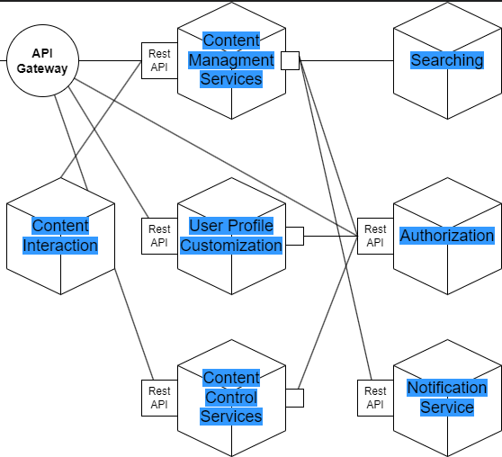
SYSTEM DESIGN

Slide 15


SYSTEM DESIGN

Slide 16
SPRINT

Slide 17
1
SPRINT
Sprint 1 – Research and Blueprint of the Project
Analyzing already available blogging website.
Setting the foundation for the project environment.(backend, frontend, version control etc.)
Identifying the core required microservices(Blog interaction, Blog Post, Search etc.) for the website.
Understanding the working of containers.
Understanding the working of K8s.
Choosing appropriate project management tool like trello/jira.
Designing the architecture of the website.
Time Period – 1 week

Slide 18
2
SPRINT
Sprint 2 – Start the development based on the research done in sprint 1
User Authentication
Story: A new user will be able to register and login their account to our blogging website so that they can access the blogging services
Acceptance Criteria:
User must provide a valid email address.
Password must meet security requirements(eg. Minimum length, use special characters, use of both upper and lowercase)
2. Integration of frontend and backend tools identified in sprint 1
Creating MongoDb database and Container for user authentication microservice
Time Period: 1 week

Slide 19
THANK YOU

